Slide 1
CSET301 (AI-ML)
Lecture 8: Datasets, Evaluation metrics
Deepika Vatsa

Slide 2
Outline
Datasets
Training, test, and validation
Evaluation metrics
Accuracy, Confusion matrix, Precision, Recall, F1-score

Slide 3
Model training and evaluation
The first rule of machine learning says —
Don't use the same dataset for model training and model evaluation.
To build a reliable machine learning / deep learning model, we need to split the dataset into the training, validation, and test sets.
Else it would not be reliable and the results would be biased.

Slide 4
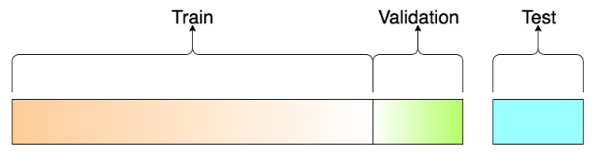
Data sets: Train, Test, Validation
Training Dataset: The sample of data used to fit the model.
The actual dataset that is used to train the model.
The model sees and learns from this data.
The training set should have a diversified set of inputs so that the model is trained in all scenarios and can predict any unseen data sample

Slide 5
Data sets: Train, Test, Validation
Validation set: A set of data used to validate our model performance during training (used to tune the hyperparameters and make model selection decisions).
The model never learns from this data.
The model is trained on the training set, and, simultaneously, the evaluation is performed on the validation set after every iteration.
It provides an estimate of the model's performance on unseen data during training, allowing for adjustments to the model's architecture or training process without touching the final test set.
Prevents overfitting
Notes:
It is like a critic telling us whether the training is moving in the right direction or not.
So it helps us identify whether our model is overfitting or underfitting or generalizing well on the data.
And based on that we can decide on the changing hyperparameters of the model.
It not only tells how well our model is learning the features of the training data, but also how well the model is generalizing to new, unseen data from the validation set.
In model.fit() function only, we give validation set, and it will print loss value, accuracy, acc_valid, loss_valid (training loss and accuracy and validation set loss and accuracy).

Slide 6
Data sets: Train, Test, Validation
Test set: A set of data used to test the model performance after completing the training.
It provides an unbiased final model performance metric in terms of accuracy, precision, recall, etc.

Slide 7
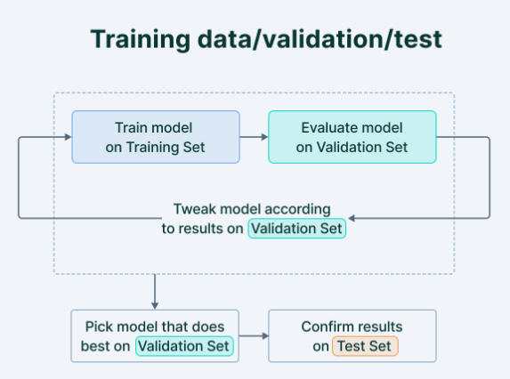
Data sets: Train, Test, Validation
Notes:
Using validation and test sets will increase the generalizing capability of the model on new unseen data

Slide 8
Data sets: Train, Test, Validation
SPLIT RATIO
Generally, we first split the dataset into 2 — Train and Test.
Then, randomly choose X% of the Train dataset to be the actual Train set and the remaining (100-X)% to be the Test set, where X is a fixed number(say 80%)

Slide 9
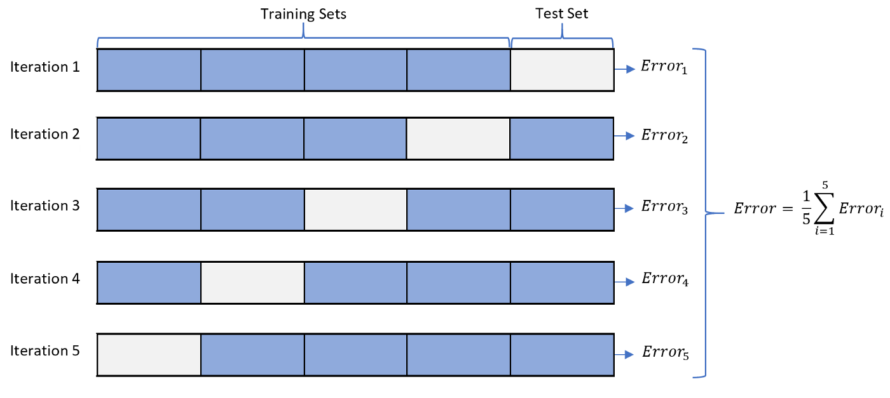
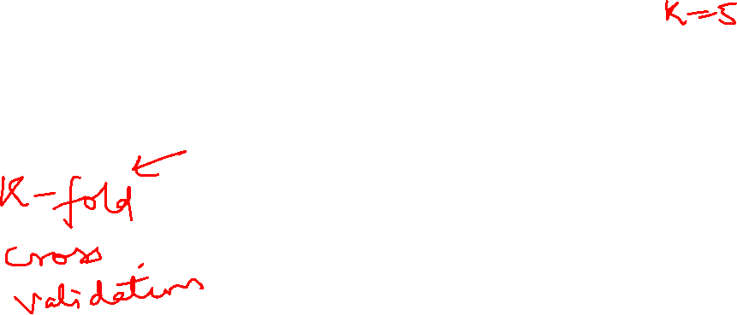
Data sets: Train, Test, Validation
CROSS-VALIDATION
The model is iteratively trained and validated on different sets.
Cross-validation avoids overfitting.
Useful in case of limited data

Slide 10
Data sets: Train, Test, Validation
Many hyperparameters to tune, a larger validation set is required to optimize the model’s performance.
Fewer or no hyperparameters, then easy to validate the model using a small set of data.

Slide 11
Evaluation metrics
Accuracy
Confusion Matrix
Precision
Recall
F1-score

Slide 12


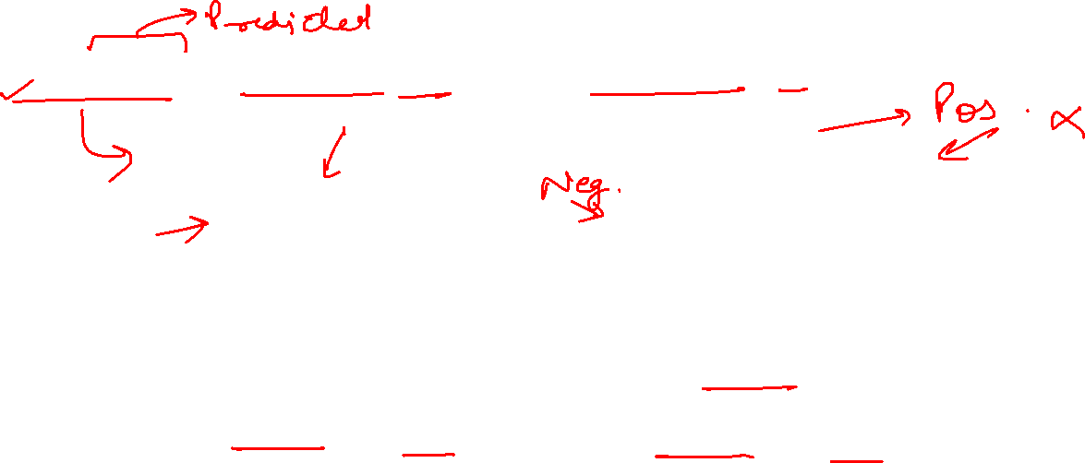
Evaluation metrics
True Positive: Actual class is positive and predicted class is positive
False Positive: Actual class is negative but the predicted class is positive.
Notes:
False Positive: means outcome of prediction is positive and prediction is false.

Slide 13


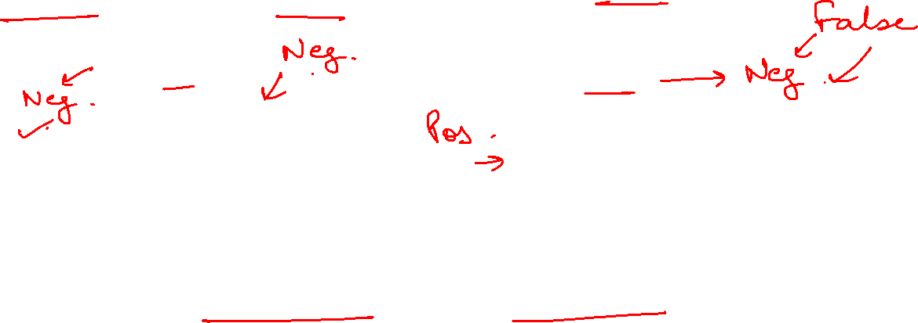
Evaluation metrics
True Negative: Actual class is negative and predicted class is negative
False Negative: Actual class is positive but the predicted class is negative

Slide 14
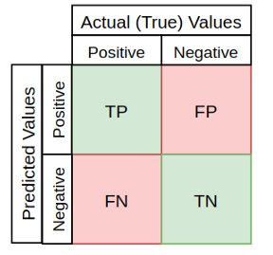
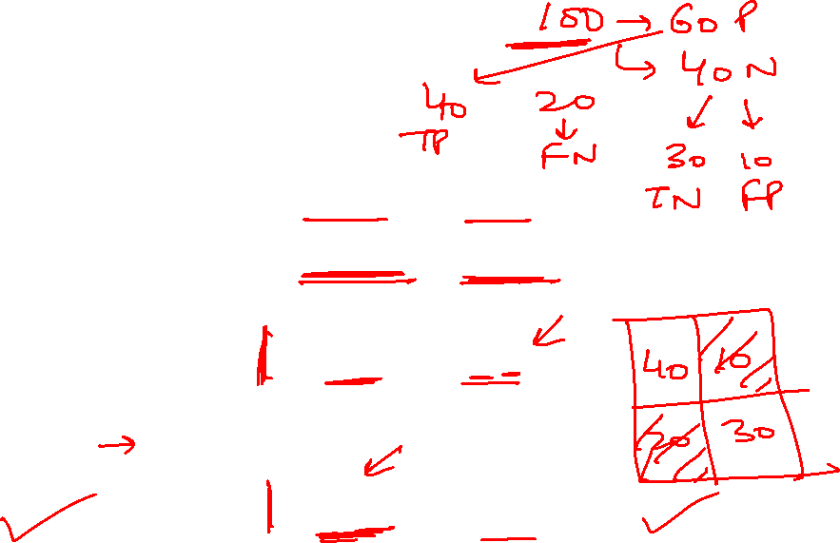
Confusion matrix
Performance evaluation matrix

Slide 15
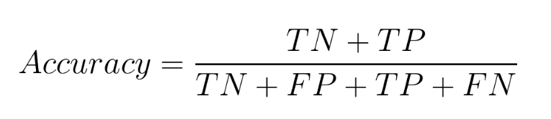
Accuracy
The number of correctly classified data instances over the total number of data instances.
Not a good measure if the dataset is not balanced (both negative and positive classes have different number of data instances)
Notes:
Unbalanced data:

Slide 16
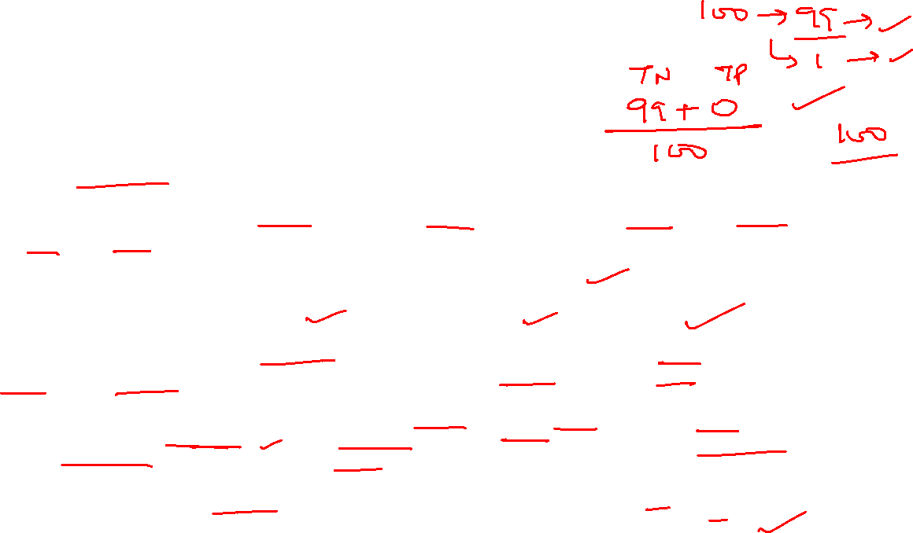
Why accuracy is misleading?
Example: Fraud Detection
Consider a credit card fraud detection dataset where 99% transactions are legitimate (majority class) and only 1% are fraudulent (minority class).
Scenario: A ML model is developed to identify fraudulent transactions.
Problem: If the model predicts "legitimate" for every single transaction, accuracy: 99%.
This high accuracy suggests excellent performance, but the model is completely useless for its intended purpose – identifying fraud. It fails to detect any of the crucial minority class instances.
Why Accuracy Fails: Accuracy is calculated as (True Positives + True Negatives) / Total Instances. In this case, the large number of true negatives (correctly classified legitimate transactions) dominates the calculation, masking the complete failure to identify true positives (fraudulent transactions).
Conclusion: In such imbalanced scenarios, alternative metrics like Precision, Recall, F1-score, or Area Under the Receiver Operating Characteristic (ROC AUC) curve are more appropriate.
Notes:
Unbalanced data:

Slide 17
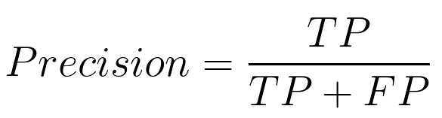
Precision
Defines how precise is our prediction
Tells us true positives out of all positive predictions.
Precision should ideally be 1 (high) for a good classifier.
Precision becomes 1 only when the numerator and denominator are equal, this also means FP is zero.
As FP increases the value of the denominator becomes greater than the numerator and the precision value decreases
Notes:
Out of all predictions, how any are correct.

Slide 18

Recall
Also known as sensitivity or true positive rate.
Also equals to TP / P (true positives out of actual positives)
Recall should ideally be 1 (high) for a good classifier.
Recall becomes 1 only when the numerator and denominator are equal, this also means FN is zero.
As FN increases the value of the denominator becomes greater than the numerator and the recall value decreases
Notes:
Recall tells us how many are true positive out of total positives.

Slide 19
Precision and Recall
So ideally in a good classifier, we want both precision and recall to be 1 which also means FP and FN are zero

Slide 20
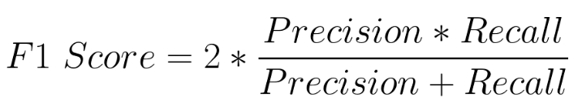
F1 score
F1-score is a metric that considers both precision and recall and is defined as follows:
F1 Score becomes 1 only when precision and recall are both 1.
F1 score becomes high only when both precision and recall are high.
F1 score is the harmonic mean of precision and recall and is a better measure than accuracy.

Slide 21
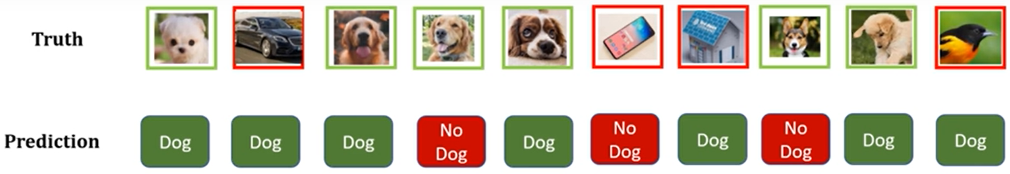
Example
Dog (Green Box): Positive class, No dog (Red Box): Negative class

Slide 22
Example
Identifying true positive and false positives

Slide 23
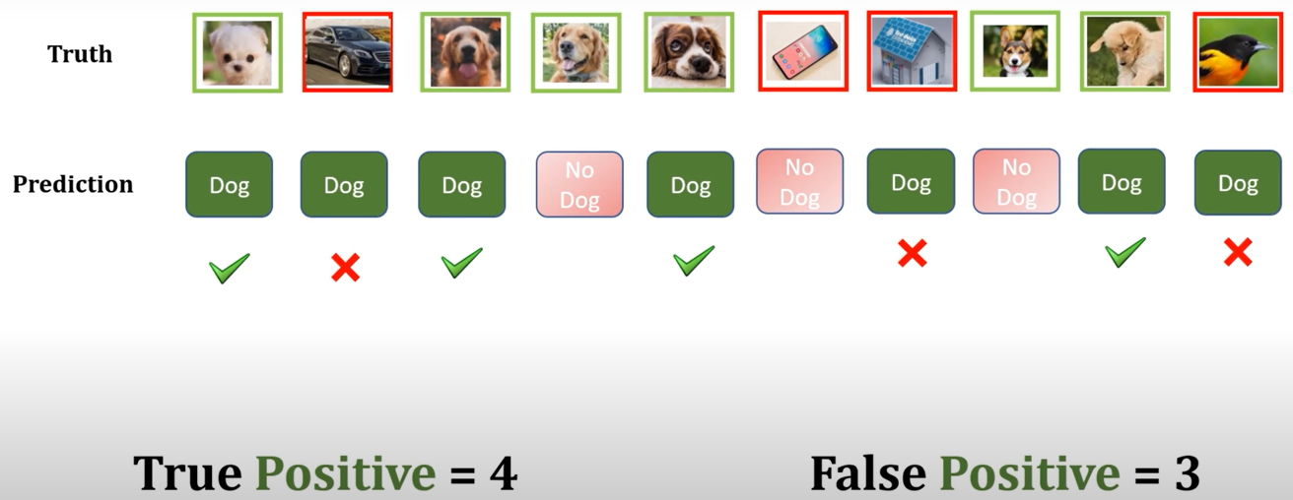
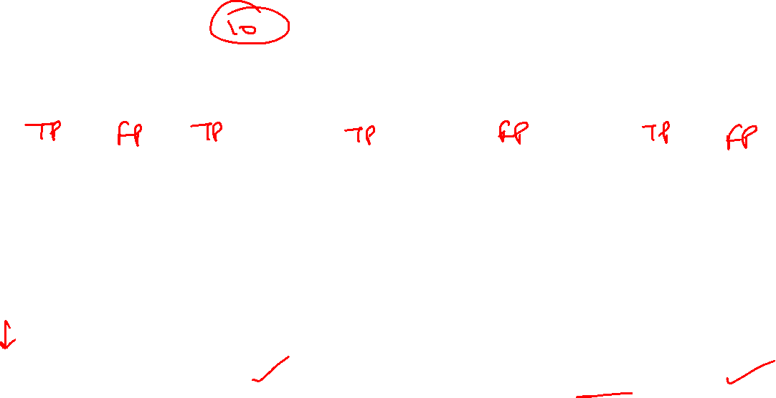
Example

Slide 24
Example
Identifying true negative and false negative

Slide 25
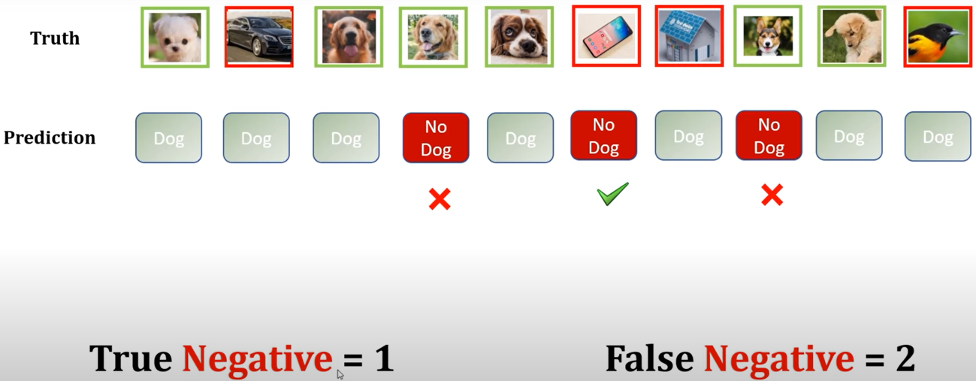
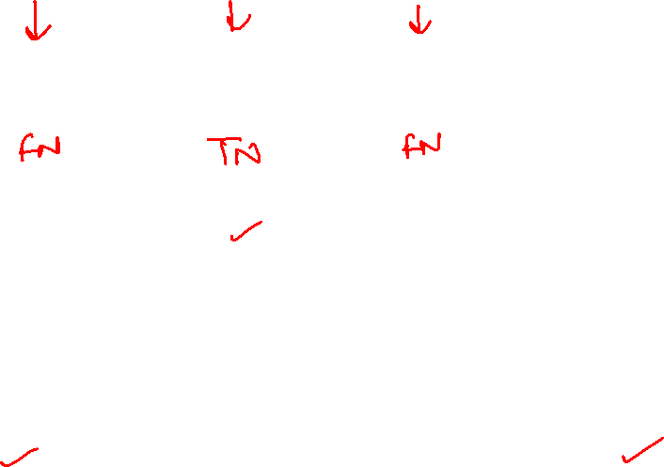
Example

Slide 26
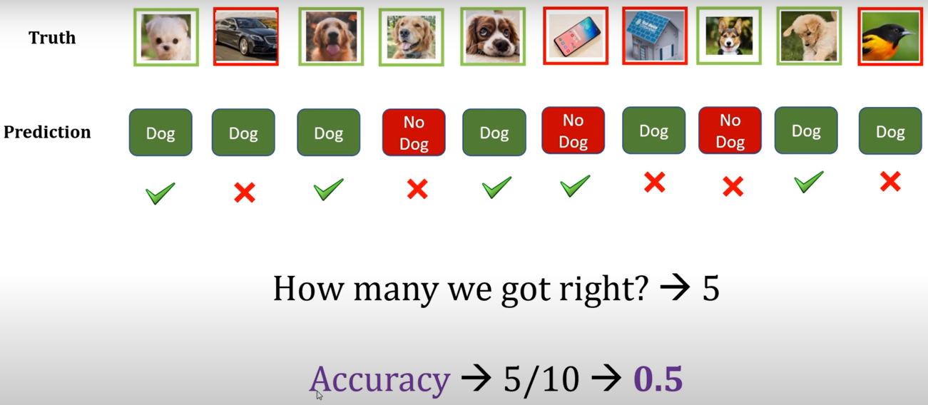
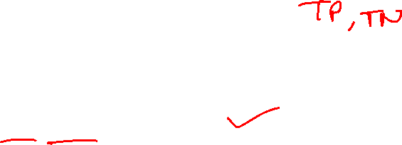
Example

Slide 27
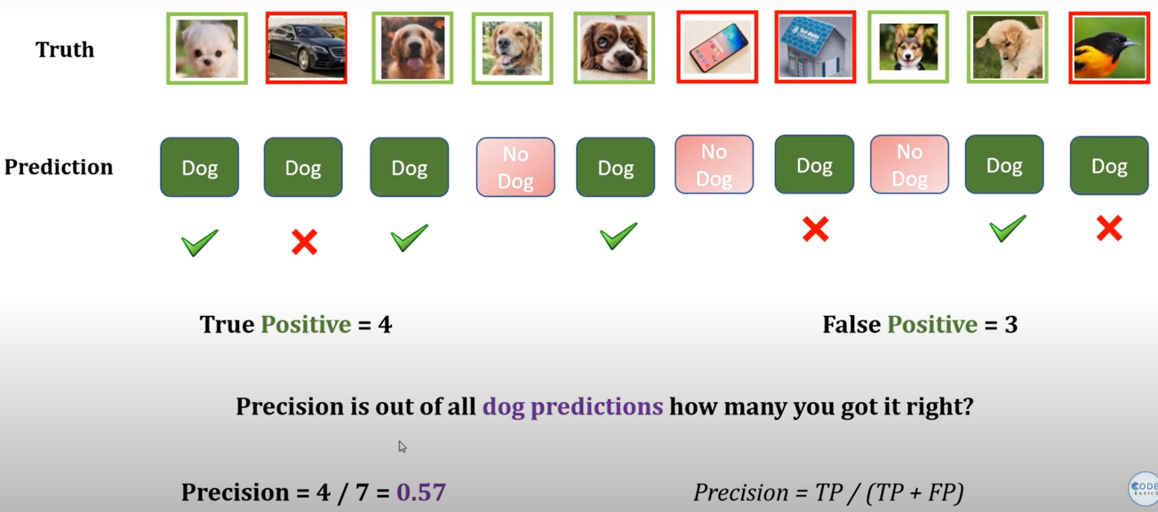

Example

Slide 28
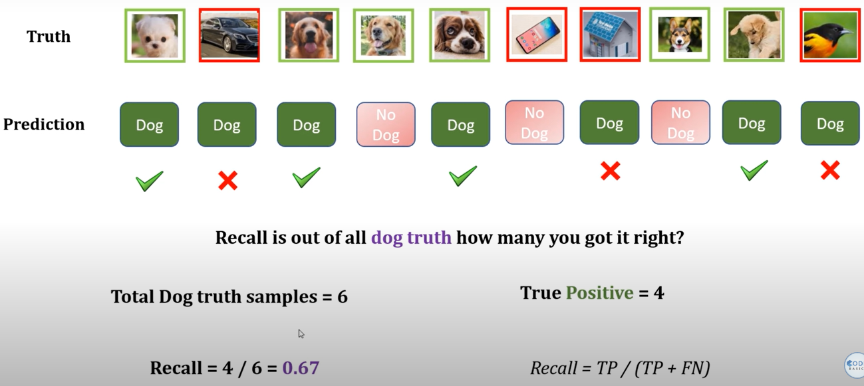
Example

Slide 29

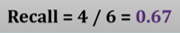
Example
F1 score: 0.6159
Notes:
For “not a dog”, precision is 0.33 , recall is 0.25
Precision : Out of three predictions of “no dog”, only one is correct.
Recall: Out of 4 actual “no dog” images, only one is correct.
F1 score : 0.284

Slide 30
References
Train Test Validation Split: How To & Best Practices
https://www.v7labs.com/blog/train-validation-test-set

